Slide 1
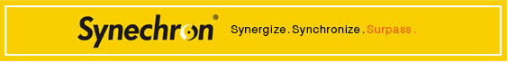
Application lifecycle
Badri prem kumar

Slide 2
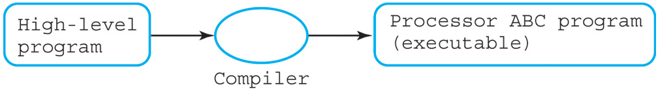
Compiler
Software that translate high-level language (C++, Java, C#, etc) to machine language.
Compiler X can covert high-level Y to machine language Z.

Slide 3
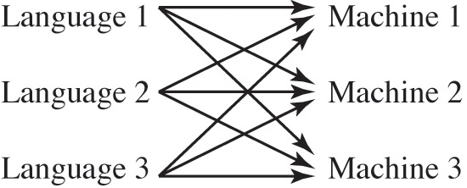
Problem
A big problem facing developers is the many different types of processors that run code.
So if we have 3 programming languages and 3 devices, how many compilers do we need?
So, how they solved this?!

Slide 4
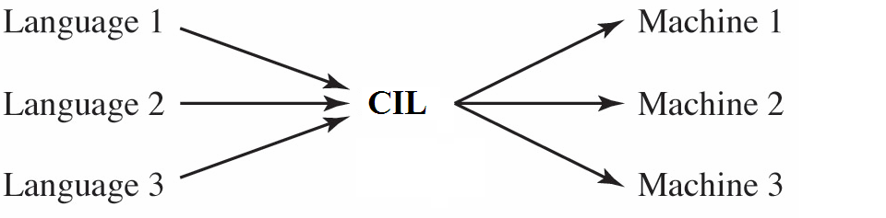
Two Steps Compilation Process
Compilation is done in two steps:
At compile time: compile each language (C#, C++, etc) to Common Intermediate Language (CIL)
At runtime: Common Language Runtime (CLR) uses a Just In Time (JIT) compiler to compile the CIL code to the native code for the device used
Compile Time
Run Time

Slide 5
Application lifecycle
VB.NET
C#.NET
C++.NET
VB Compiler
C# Compiler
C++ Compiler
Common Independent Language (CIL)-Assembly
Common Language Runtime (CLR)
JIT Compiler
Native code
Operating System Services
Output Console/GUI

Slide 6
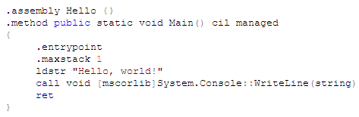
Common Intermediate Language (CIL)
Much like the native languages of devices.
CIL was originally known as Microsoft Intermediate Language (MSIL).
CIL is a CPU- and platform-independent instruction set.
It can be executed in any environment supporting the .NET framework
Hello World Example in CIL

Slide 7
CIL-Assembly
It consist the information about assembly
It will keep the version of the assembly and
It keep the list of the other assembly's
Manifest
Meta Data
IL(code)
Intermediate language code of the program

Slide 8
Execution engine
Common Language Runtime (CLR) is the execution engine
loads IL
compiles IL
executes resulting machine code
CLR
Runtime
compiler
Execute
IL
machine code

Slide 9
JIT runtime compile
CIL is compiled into machine code at runtime by the CLR
compiles methods as needed
called just in time (JIT) compile
JIT compilation model:
first time method is called the IL is compiled and optimized
compiled machine code is cached in transient memory
cached copy used for subsequent calls
Cache
machine code for F()
CIL code
F()
G()
H()
JIT runtime
compiler
Execute

Slide 10
NGEN install time compile
Can compile CIL into machine code when app installed
use native image generator ngen.exe
can speed startup time since code pre-compiled
but cannot do as many optimizations
original IL must still be available for type information
CLR
native
image
cache
ngen
Execute
IL
machine code

Slide 11
Summery
The compiler compiles the source code into the module, which is finally converted into the assembly.
The assembly contains the Intermediate Language (IL) code along with the metadata information about the assembly.
The common language runtime (CLR) works with the assembly. It loads the assembly and converts it into the native code to execute the assembly.
Then this native code is executed by the Operating system and the output will shows according to your requirement.

Slide 12


